Slide 1


INTRODUCTION
Let’s Get Started

Slide 2
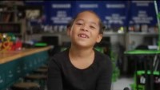
What is FIRST® LEGO League Explore?
Notes:
What is Explore video
YouTube link: https://youtu.be/afYrsiQ48wA

Slide 3


Welcome!
I’m Ruby!
I’m Jacob!
We are excited to join you on
your team journey! Come along
with us as we guide you through
the CARGO CONNECTSM
challenge.
Notes:
Welcome to CARGO CONNECTSM
Welcome to the FIRST® FORWARDSM season. This year’s FIRST LEGO League Explore Challenge is called CARGO CONNECTSM. Children will learn about how cargo is transported, sorted, and delivered to its destinations. As more demands are placed on transportation systems, children need to rethink how cargo is transported from place to place. We have the power to build a path forward and invent the future of transportation. And it starts here, with you.

Slide 4
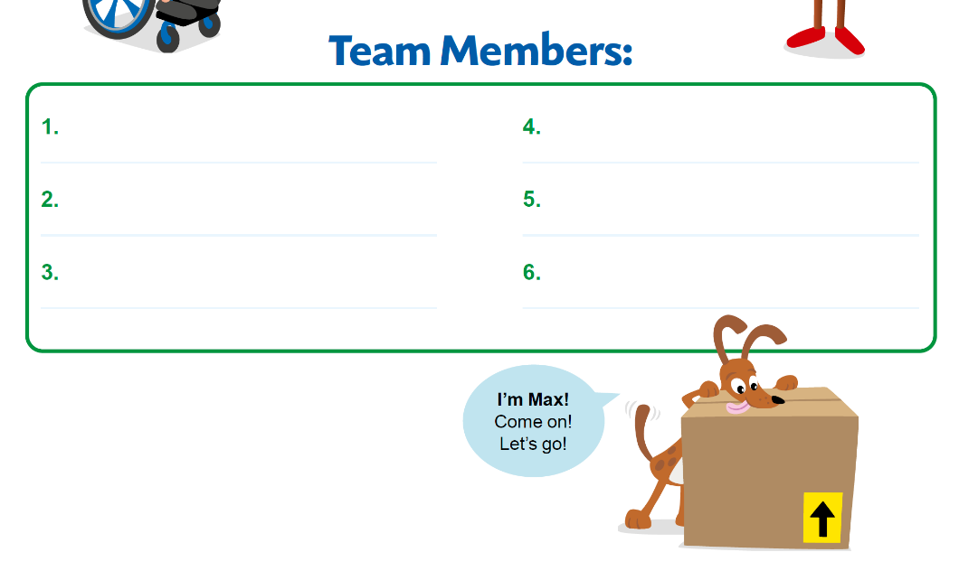

Form Your Team
Write your Team Members’ Names in your Engineering Notebook.
Notes:
Working in Teams
Children work together in teams of six using pieces from the LEGO® Education WeDo 2.0 set, and a CARGO CONNECT Explore set. They will collaborate and communicate to build, learn, and play together.
Children should be encouraged in every session to work with their teammates, listen to each other, take turns, and share ideas and pieces.

Slide 5
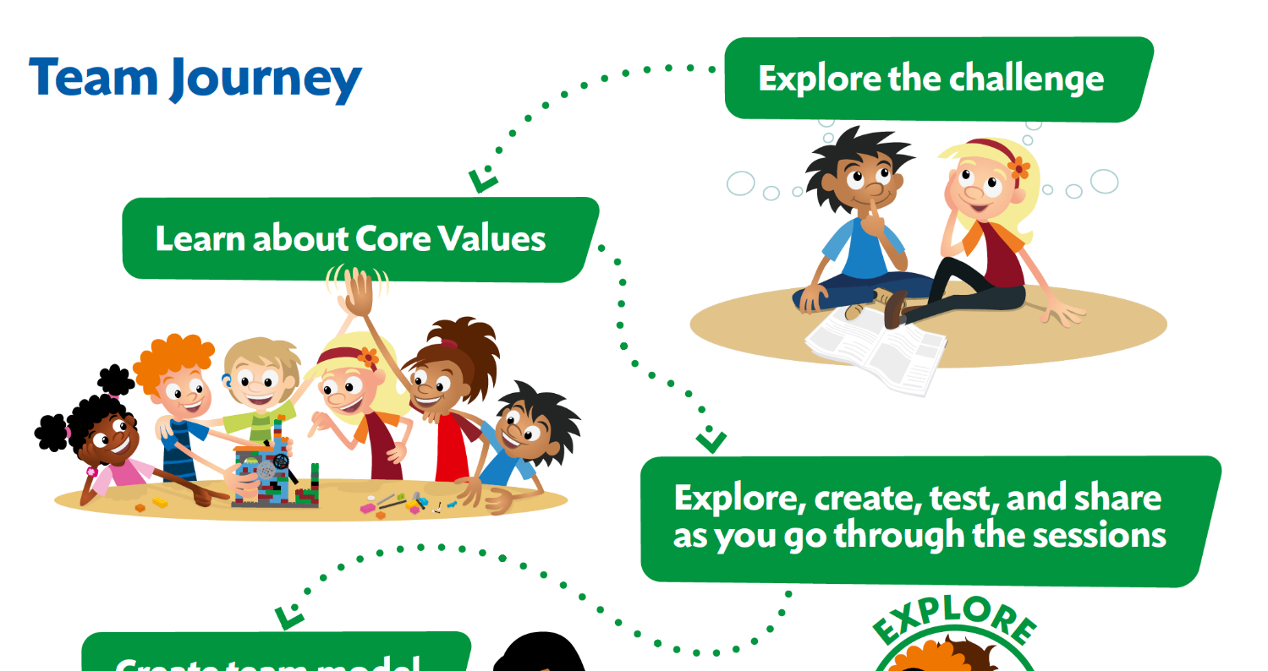

Slide 6

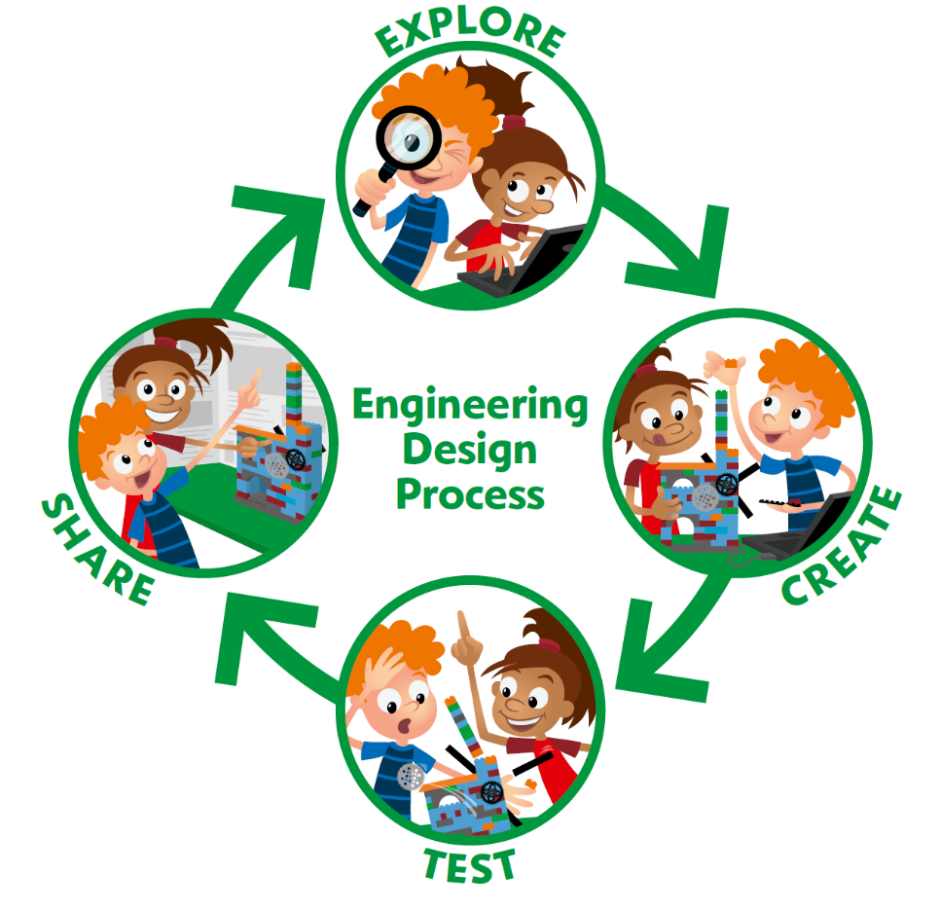
Notes:
During each session, they will experience the engineering design process. There is no set order for this process, and they may go through each part several times in a single session. This means that during a session, children will be exploring the theme and ideas, creating solutions, testing them, iterating and changing them, and then sharing what they’ve learned with others.

Slide 7
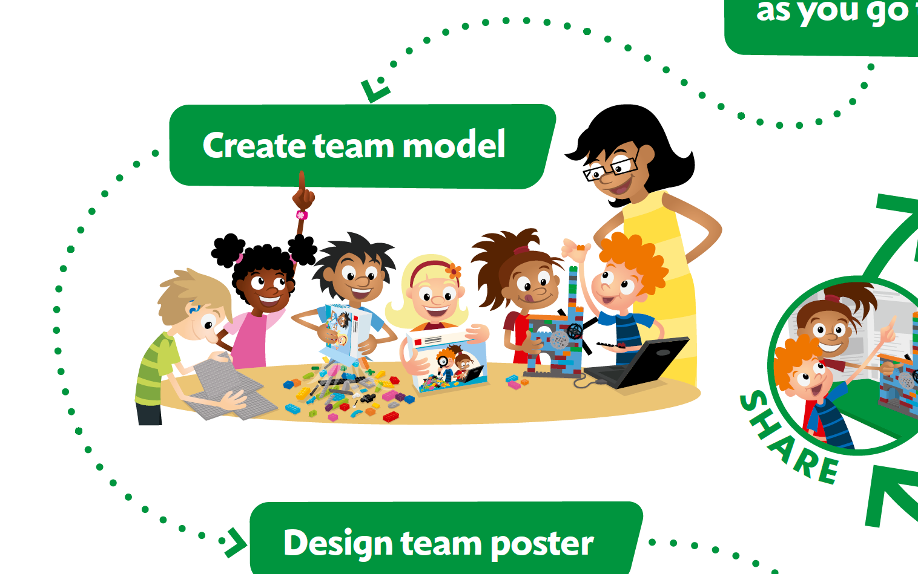

Slide 8
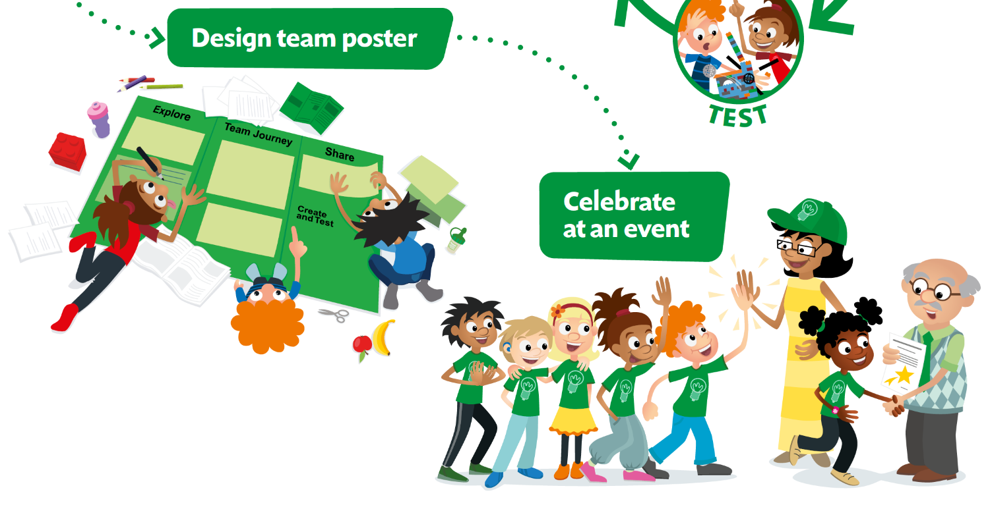

Slide 9

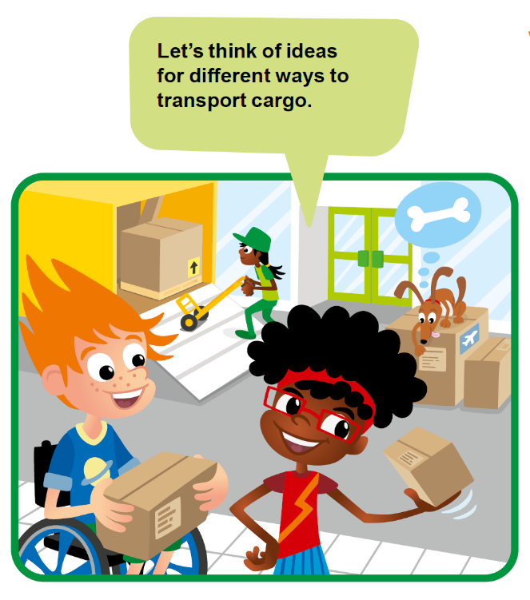
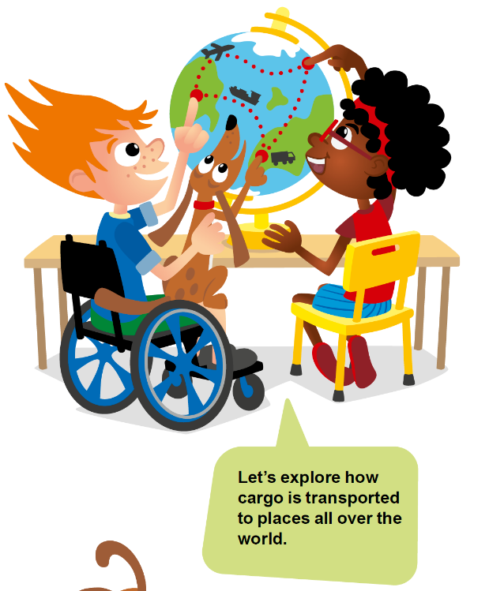

Slide 10
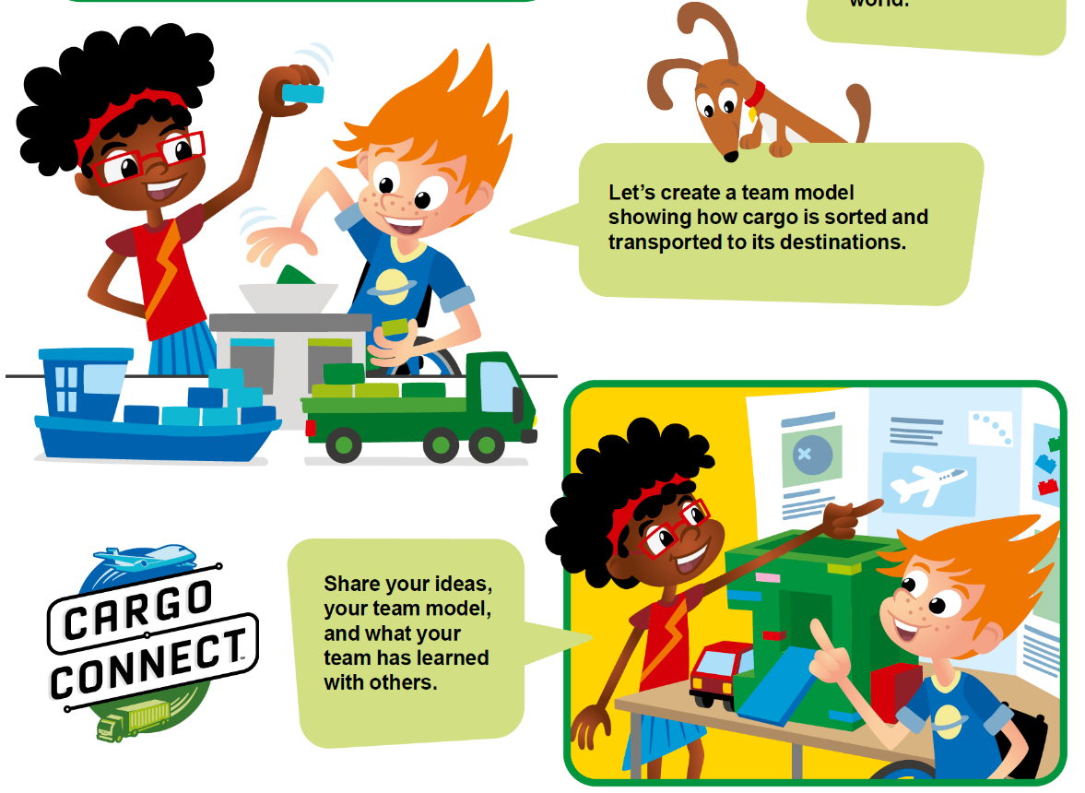

Slide 11
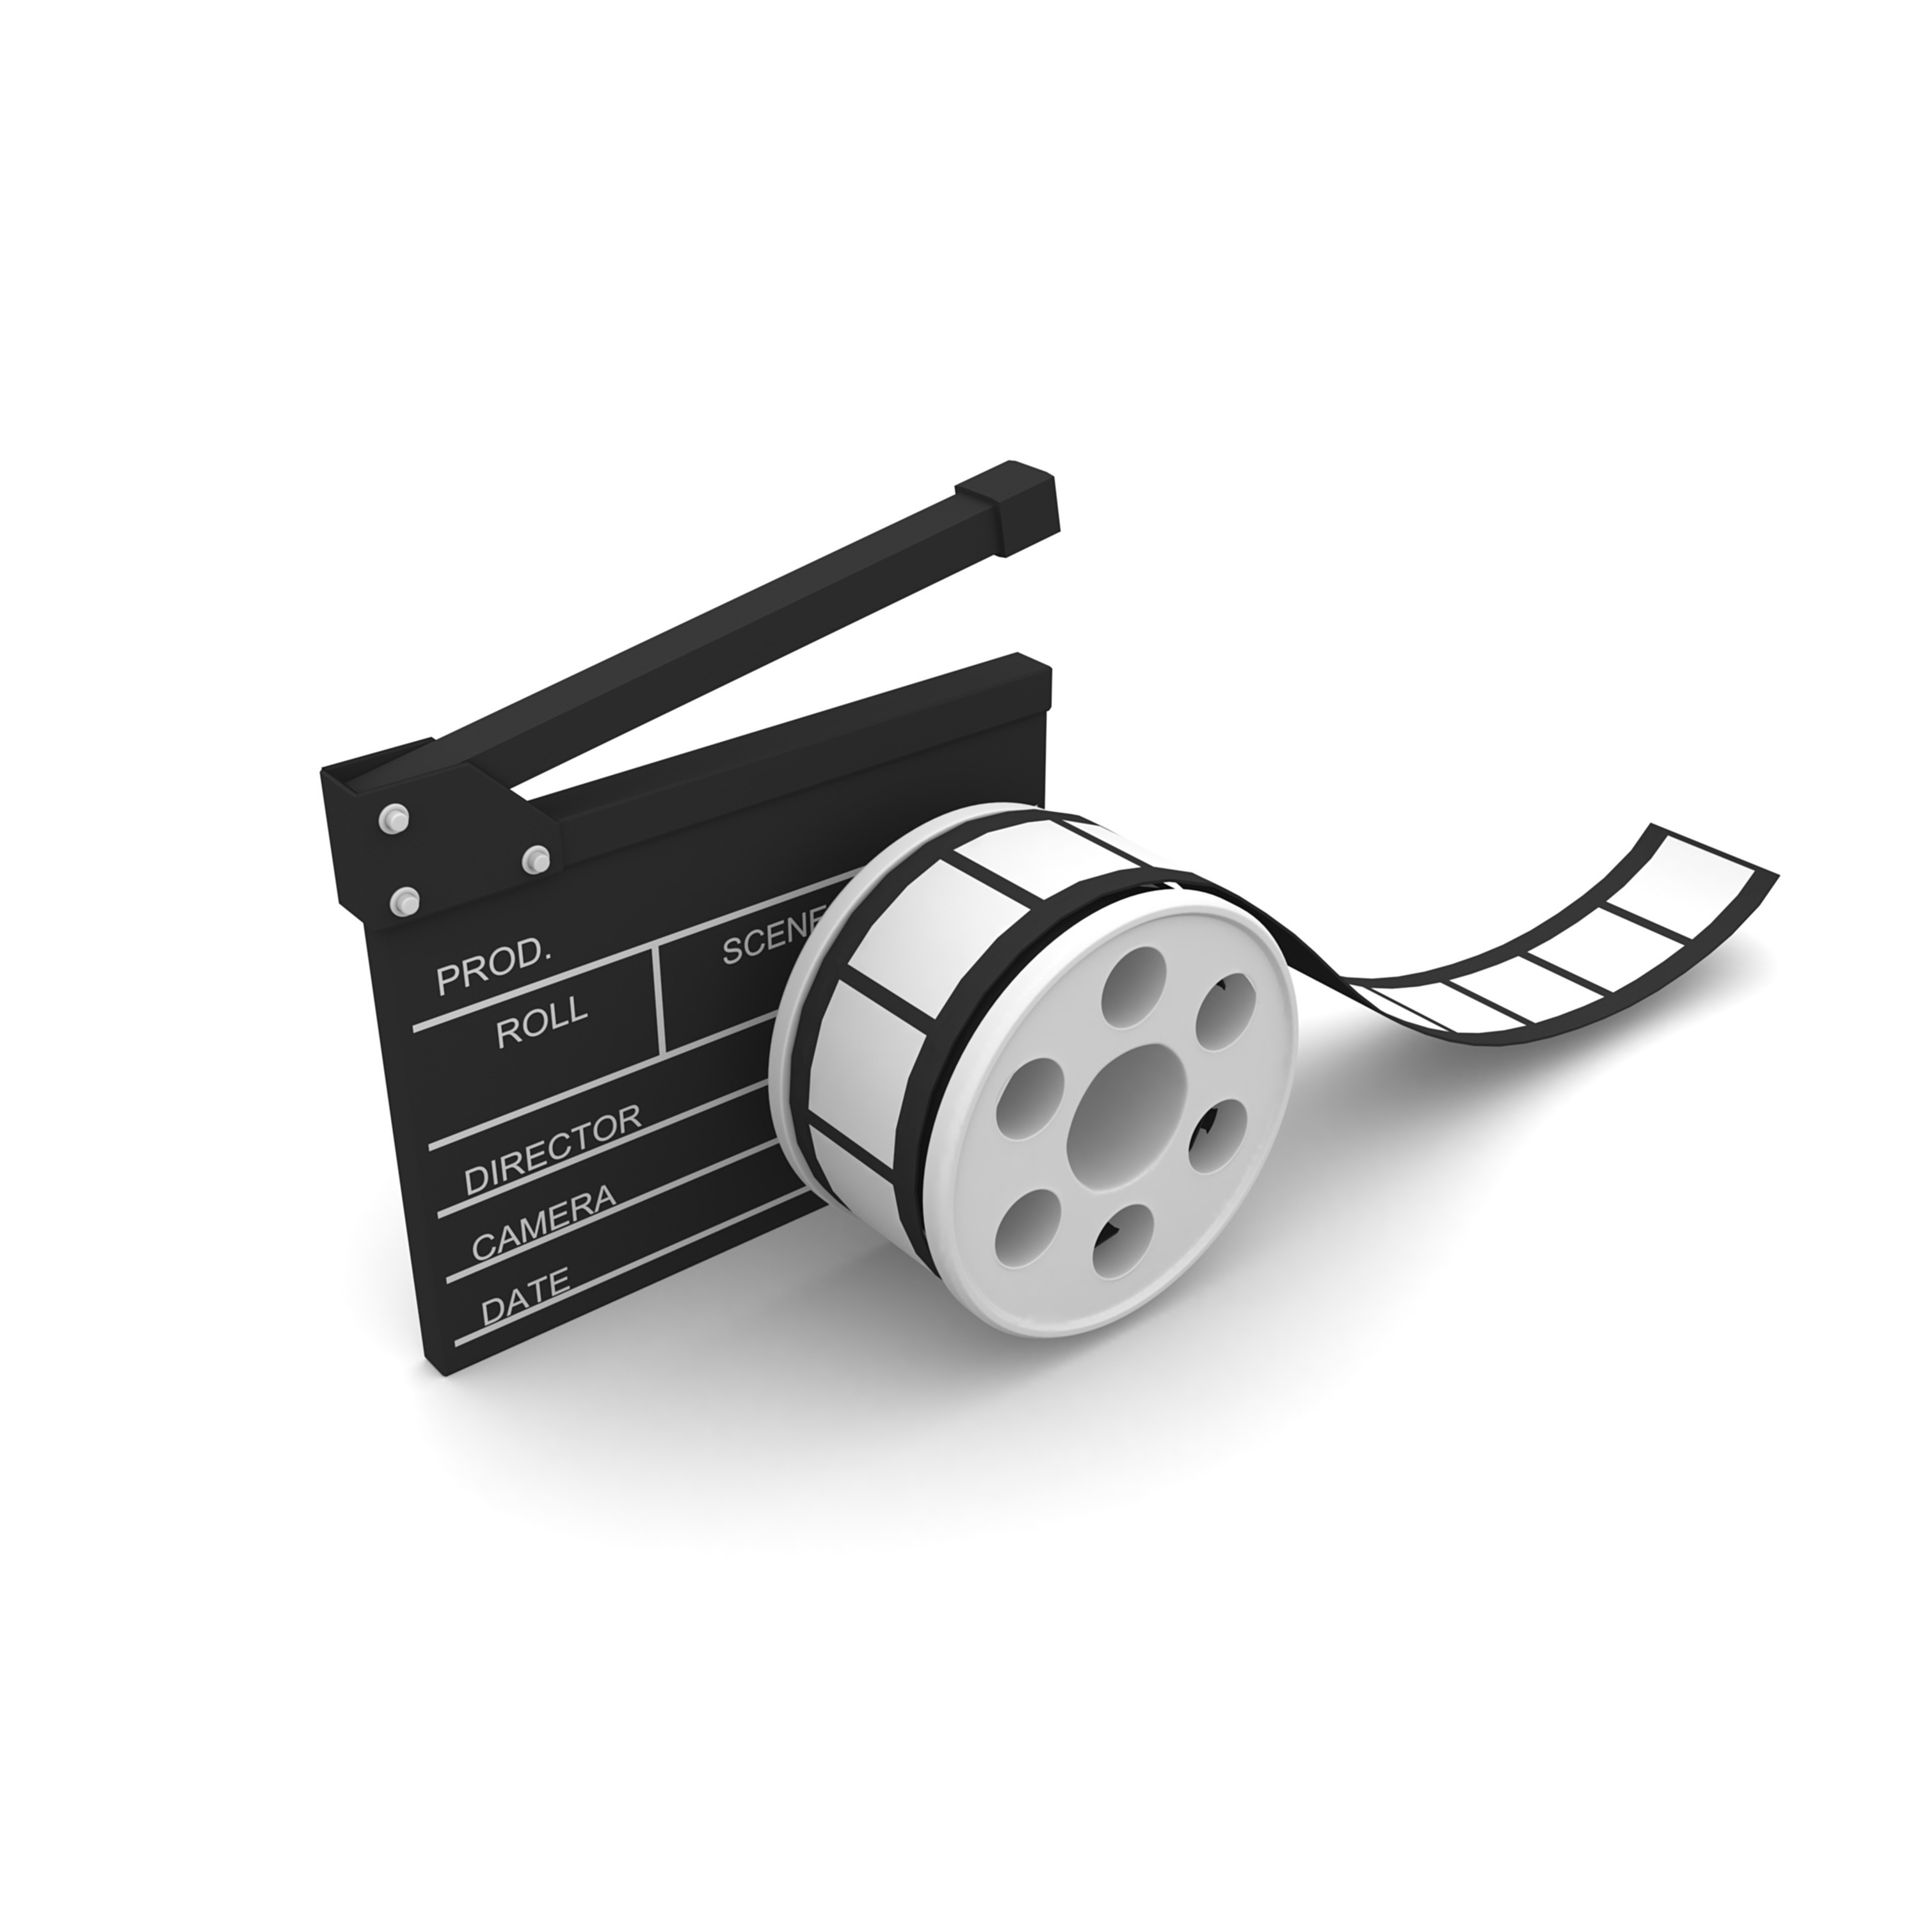
CARGO CONNECTSM
Visit the
FIRST® LEGO ® League
YouTube Channel
to watch the
CARGO CONNECTSM Season Launch Video
Notes:
Tasks (40 minutes)
Gather your completed team model and team poster.
Talk about what your team would like to share at your event!
Complete the next page to prepare for your event.
Look over the reviewing sheet with your coach.

Slide 12

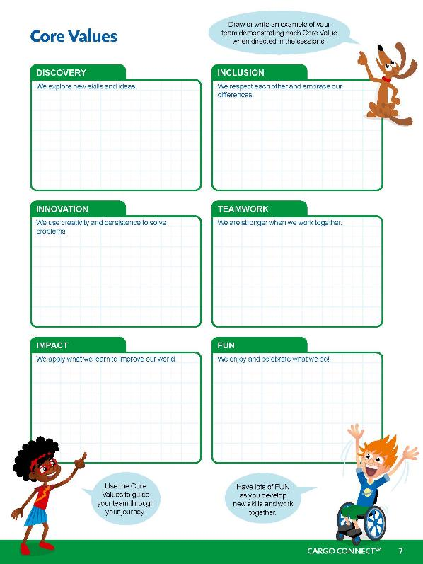
Core Values
Notes:
Draw or write an example of your team demonstrating each Core Value when directed in the sessions!
Use the Core Values to guide your team through your journey.
Have lots of FUN as you develop new skills and work together.

Slide 13
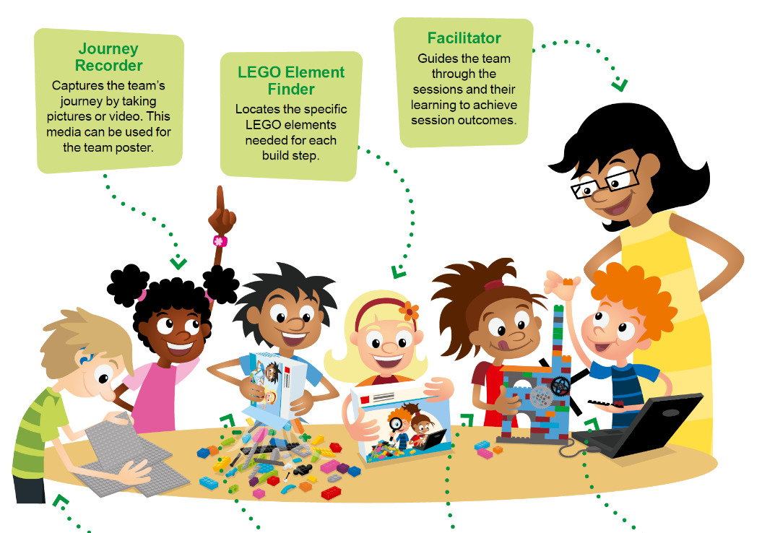
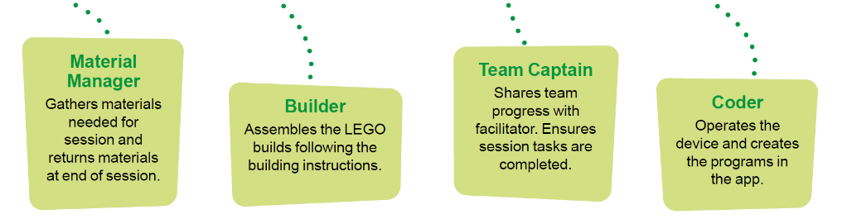
Team Roles
Notes:
Here are sample team roles to use during the sessions. Everyone on the team could experience each role multiple times throughout their FIRST® LEGO® League Explore experience. Using roles helps the team function more efficiently and ensures that everyone on the team is engaged. Some roles will be filled by multiple children during a session. For example, the builder and coder roles can be duplicated where the experience is designed for a pair of children.

Slide 14


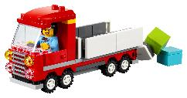

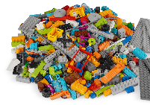
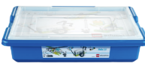
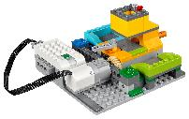
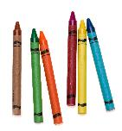


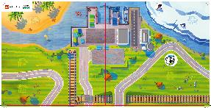
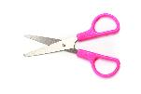
You Need
Each session lists the materials needed.
CARGO CONNECTSM Explore Set
Notes:
You might provide any instructions your students need about managing materials during the Explore sessions.
Material Management
Place any extra or found LEGO® pieces in a cup.
Have the children who are missing pieces come to the cup to look for them.
Wait to dismiss your team until you look over their LEGO set.
The lid of the LEGO set can be used as a tray to keep pieces from rolling away.
Use plastic bags or containers to store any unfinished builds and their associated pieces or assembled models.
Designate a storage space for the built models, Explore set, and LEGO container.
The role of the Material Manager is to help in the process of clearing away and storing materials.

Slide 15
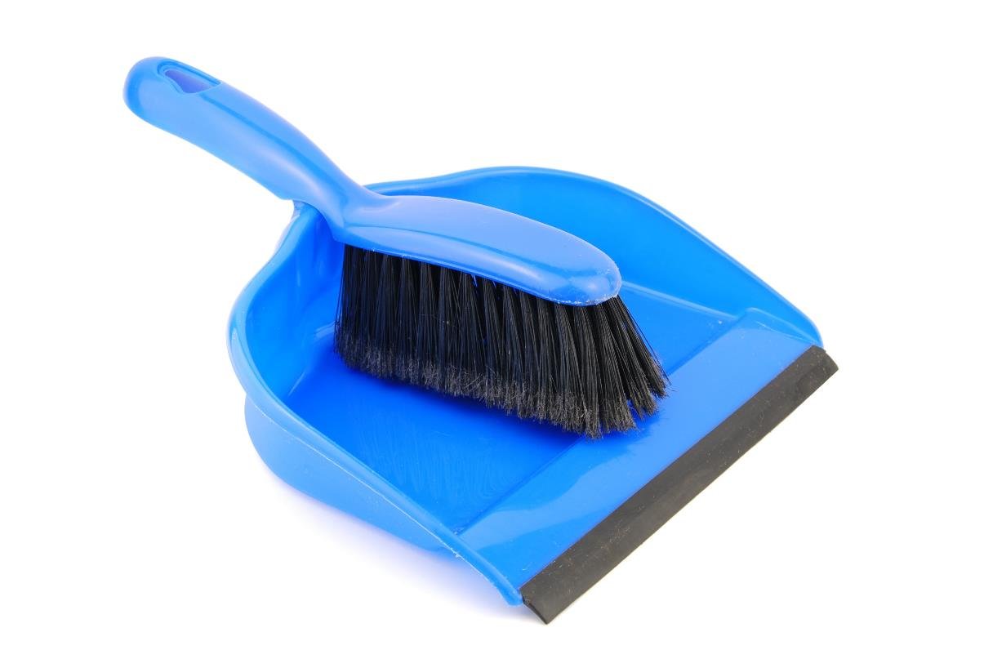
Clean Up after Every Session
Notes:
You may wish to play a video or song during clean up time Link on GoNoodle: https://family.gonoodle.com/activities/clean-up. Link on YouTube Kids: https://www.youtubekids.com/watch?v=ZJFk87ZsHn0 . Link on Youtube: https://youtu.be/ZJFk87ZsHn0

Slide 16
FIRST® and the FIRST® logo are registered trademarks of For Inspiration and Recognition of Science and Technology (FIRST). LEGO® and MINDSTORMS® are registered trademarks of the LEGO Group. FIRST® LEGO® League and CARGO CONNECTSM are jointly held trademarks of FIRST and the LEGO Group. All other trademarks are the property of their respective owners. ©2021 FIRST and the LEGO Group. All rights reserved.

